Slide 1
Regression Model Build and Test – Car Sales
Term -2 Project
Abhinav Marwah

Slide 2

Problem Statement
To model the sales prediction based on 156 observation collected for sales of car with differing manufacturer
16 variables have been considered impacting the prediction of car sales based on the data set

Slide 3
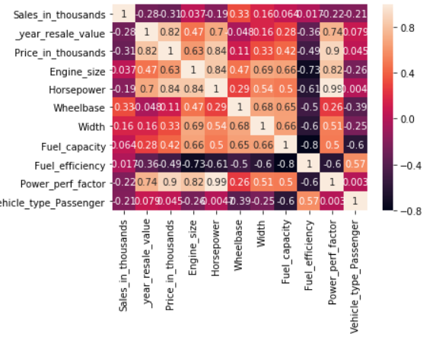
Data Analysis - Correlation
Correlation b/w independent variables
Sustaining Horsepower column and dropping others as the impact of horsepower on Sales would clearly demonstrate the impact of other fields.
Sales does not have any correlation impact with any independent factor. Therefore, other factors would be important to analyze the regression model for Sales

Slide 4
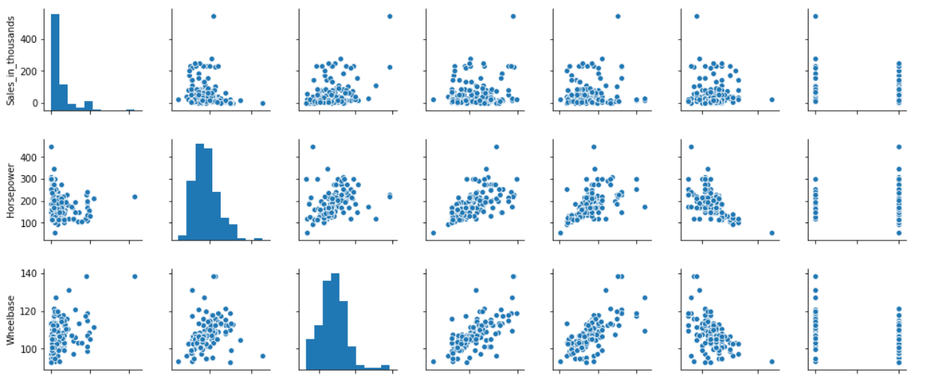
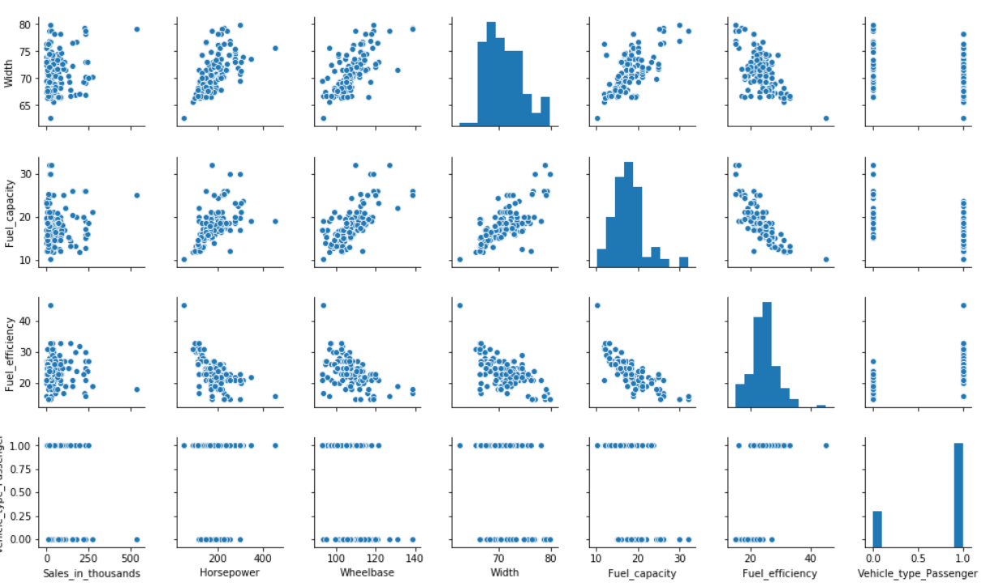
Data Analysis – Pair Plot
Pair Plot Mapping of Sales with other variables
More than 95% of the data lies within 100 to 200 horsepower range. Vehicles with low horsepower are sold higher than high horsepower
Outliers for Fuel efficiency where Sales is showing low for high fuel efficiency and high for low fuel efficiency

Slide 5
Regression Model
Best Model Fit
Model 1 equation:
Y = 58.04 – (21.36 * Horsepower) + (32.49 * Wheelbase) + (11.36 * Width) – (19.08 * Fuel Capacity) – (2.13* Fuel Efficiency) – (10.25 * Vehicle Type)
Model 2 equation:
Y = 59.52 – (24.31 * Horsepower) + (34.40 * Wheelbase) + (12.03 * Width) – (23.42 * Fuel Capacity) – (6.18* Fuel Efficiency) – (9.4 * Vehicle Type)
From the analysis based on model 1 and model 2, for train data the RMSE is less for model 1 and for test data the RMSE is less for model 2
Model 1 accounts 80% of train data and 20% of test data
Model 2 accounts 70% of train data and 30% of test data

Slide 6
Thank You

